Slide 1
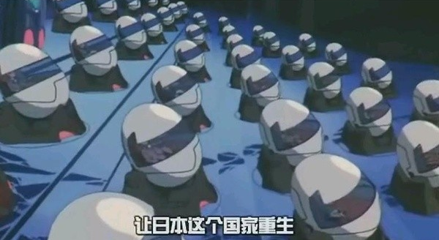
Noah's Capsule CHK001
Group 1
110064532郭孟軒
109061613黃柏凱
110061616許祐杰
111066529陳峒羽
110061901許鏡瑋

Slide 2
Outline
Introduction
Motivation and application
Architecture
Technology
Market Analysis
Task Partition
Reference

Slide 3
Part 1
Introduction

Slide 4
Introduction
Is there a product that can meet all these requirements at the same time?
Provides a comfortable immersive entertainment environment for people
Provides a place for people to have a good rest and sleep
Provides a secluded paradise for people to escape from external disturbances
Notes:
https://www.acer.com/tw-zh/predator/chairs/thronos/thronos-air
https://www.chinatimes.com/newspapers/20190412000335-260204?chdtv
有沒有產品能夠同時滿足這樣的需求呢?
1. 能夠提供人們舒適的沉浸式娛樂環境
2. 能夠提供人們好好休息睡覺的地方
3. 能夠提供人們隔離外界紛擾的世外桃源

Slide 5
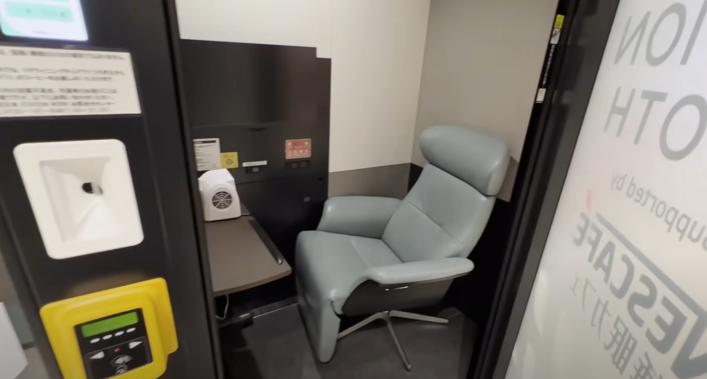
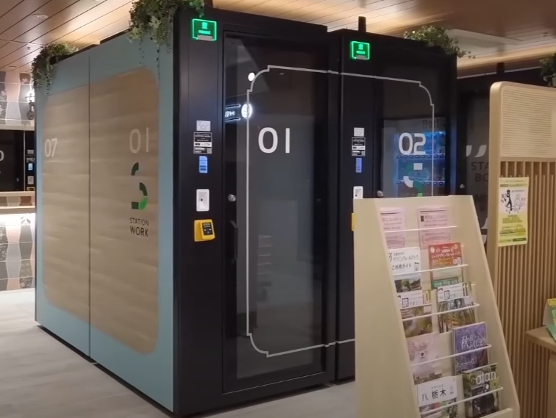
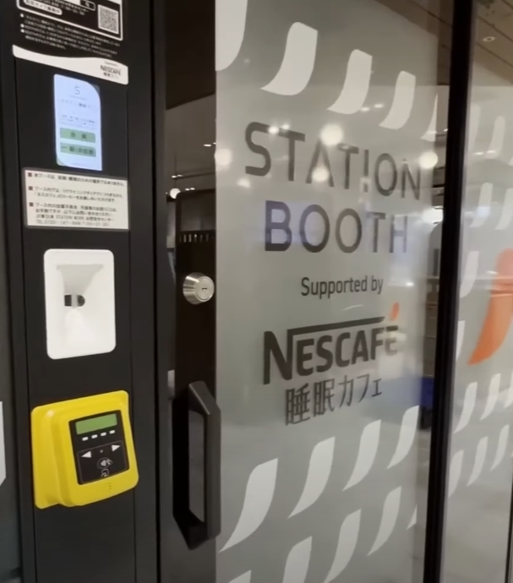
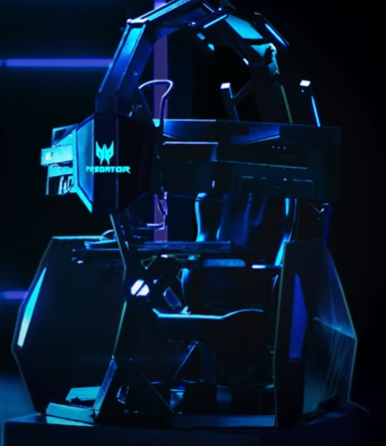
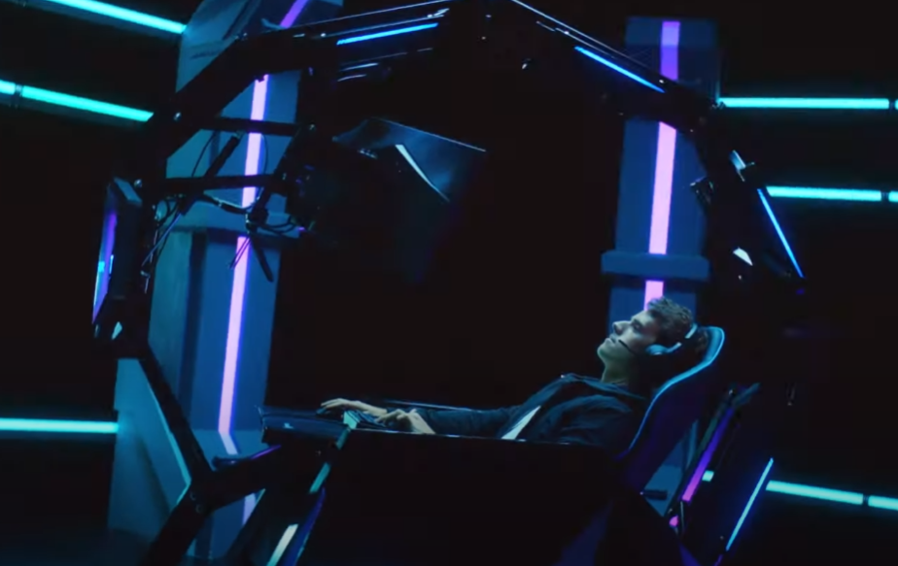
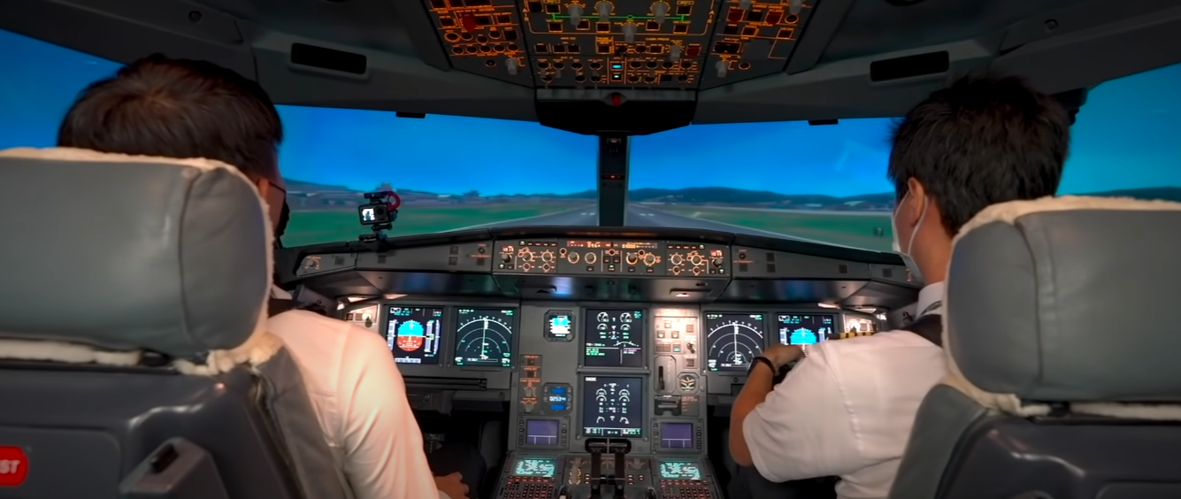

Slide 6
Part 2
Motivation and Application

Slide 7
Motivation and Application
High house Prices in City
Hight pressure in Modern Life
Self-quarantine at your home
Need a place for your own ?

Slide 8
Motivation and Application
Pleasant Modern Age
IoT Environment, Interactive Technology
immersive experience
Working experience
Gaming experience
film viewing experience
Smart home
home automation
Easily control
a truely home experience
Self-health Monitoring
Avoid sitting too long
drinking water period
Heart rate …etc.

Slide 9
Motivation and Application
immersive experience - working experience
working at any place you want .
In the ocean working with fish
on the beach working with Ocean Waves Sea Sounds
In the coffee shop working with Jazz
near the onsen …etc
working with Huge monitor .
improving your efficiency

Slide 10
Motivation and Application
immersive experience - gaming experience
Playing with 144 Hz QLED Curved Monitors
Ultra-large, ultra-wide curved screen
HDR changes the game
Built for speed
with other monitor keep in touch with your friend.
Gaming workstation
Science zero gravity, release your pressure
Touch screen control, control your own station.
Notes:
https://www.ingrem.com/G1-2022

Slide 11
Motivation and Application
Smart home
A home that takes care of your task
Lights up your way
Knows how to help
Automatically control the lights and ERV
Gives you the best experience than your home.
Notes:
https://www.ingrem.com/G1-2022 https://zh.m.wikipedia.org/zh-tw/%E5%85%A8%E7%86%B1%E4%BA%A4%E6%8F%9B%E6%A9%9F

Slide 12
Motivation and Application
Self-health Monitoring
Control your smart home with control system.
The future of health On full display.
Blood oxygen, heart rate …etc.
Drink water period.
Manage your task, and give you remind.
Also manage your pressure.
Notes:
https://www.apple.com/apple-watch-series-7/index.html

Slide 13
Part 3
Architecture

Slide 14
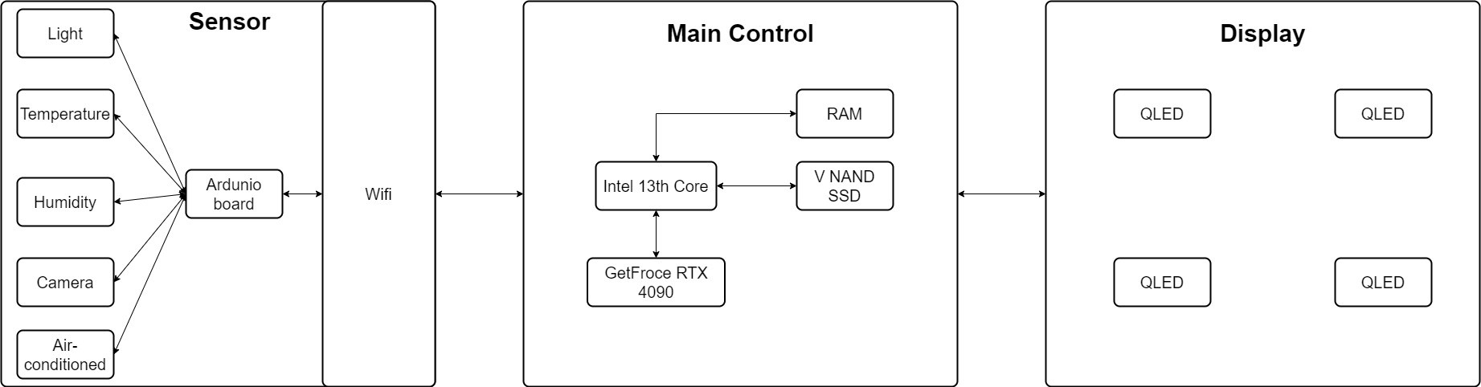
Architecture System
Notes:
再做個圖 模擬出我們實際產品的樣子

Slide 15
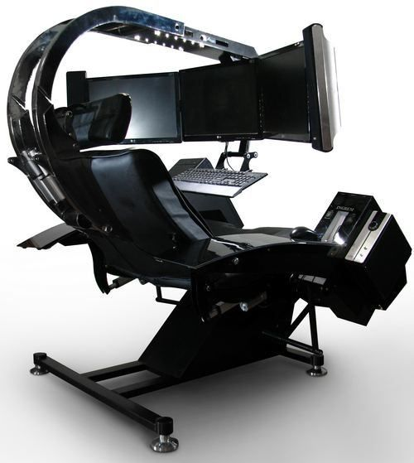
Architecture System
Display:
QLED
Sensor:
Temperature
Humidity
Air-conditioned
Camera
Light
Main Control:
Intel 13rd core
GeForce RTX 4090
RAM
SSD
Notes:
再做個圖 模擬出我們實際產品的樣子

Slide 16
Part 4
Technology

Slide 17
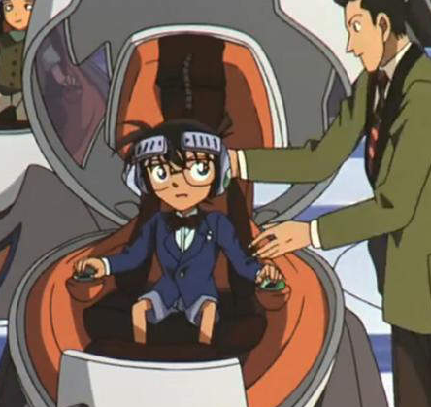
Technology - IOT Control system + Entertainment devices
Storage Device
8 TB V NAND SSD
Display
QLED Curved Monitors *2 (Main)
QLED Curved Monitors *2 (Side)
QLED Curved Monitors cover all around
CPU: Intel 13rd Core
GPU: NVIDIA GeForce RTX 4090
RAM: DDR5 up to 32GB
WIFI : WIFI 6
Blue tooth: Blue tooth 5.3
VR: Valve Index
Sensing
Camera
Temperature sensors
Humidity sensors
Light sensors
Air quality monitoring sensor
Notes:
Technology https://shop.kmb.com.tw/index.php?route=product/product&product_id=851&language=zh-TW&currency=TWD&gclid=CjwKCAjw5P2aBhAlEiwAAdY7dMgymCIa1_CM857xjDmZcp1zjtp40Dese9YmaYQDdVpKlQKVedVOqBoCEiEQAvD_BwE https://www.youtube.com/watch?v=F99YrfCzJ7o&ab_channel=Joeman

Slide 18
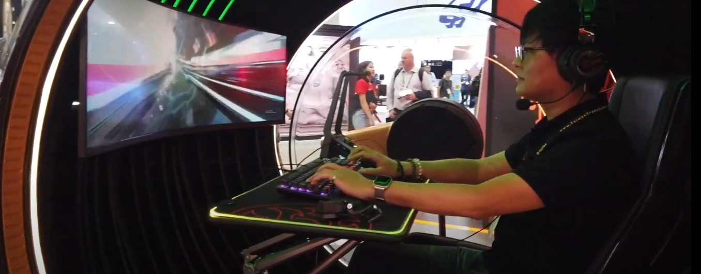
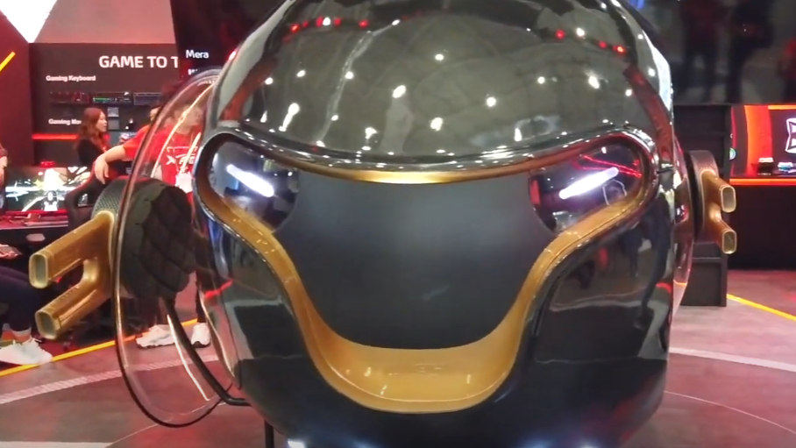
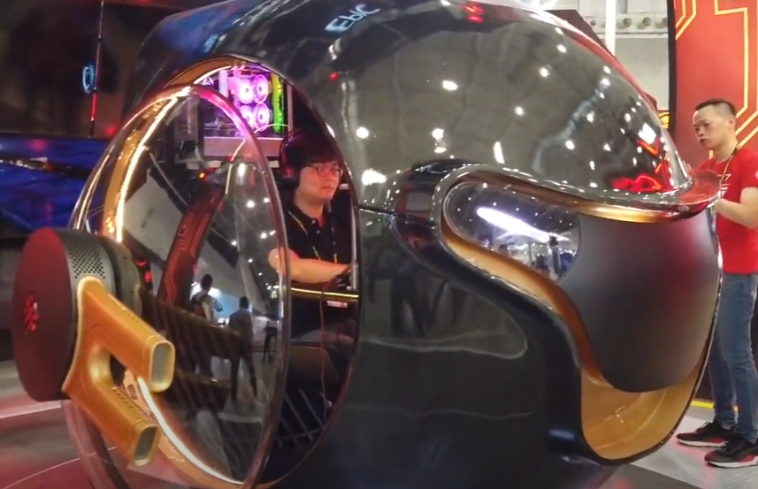
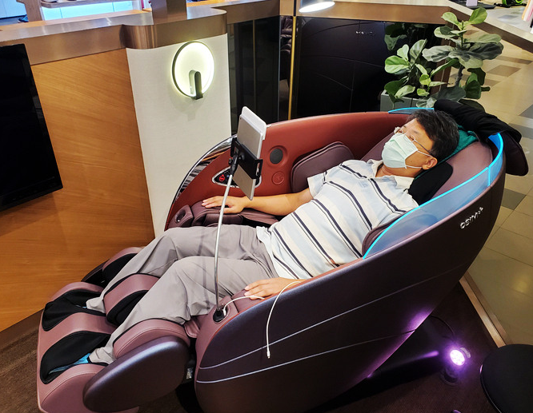
Smart Cockit
Cockit
Heat therapy : the use of infrared or heating pads to help alleviate muscle fatigue and relieve muscle spasms.
Air pressure massage : the use of pressure sensors to control air pressure for massaging muscles.
Vibration massage : the use of vibrations to relax muscles.
infrared lamp , air pressure sensor and temperature sensor, accelerometer, preasure sensor.
Notes:
熱療：使用紅外線或加熱墊來幫助減輕肌肉疲勞並減輕肌肉痙攣。
氣壓按摩：使用壓力感應器來控制氣壓進行按摩肌肉。
振動按摩：使用振動來放鬆肌肉。
紅外線燈、氣壓感應器和溫度感應器、加速度計、壓力感應器。

Slide 19
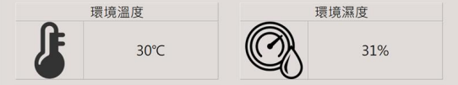
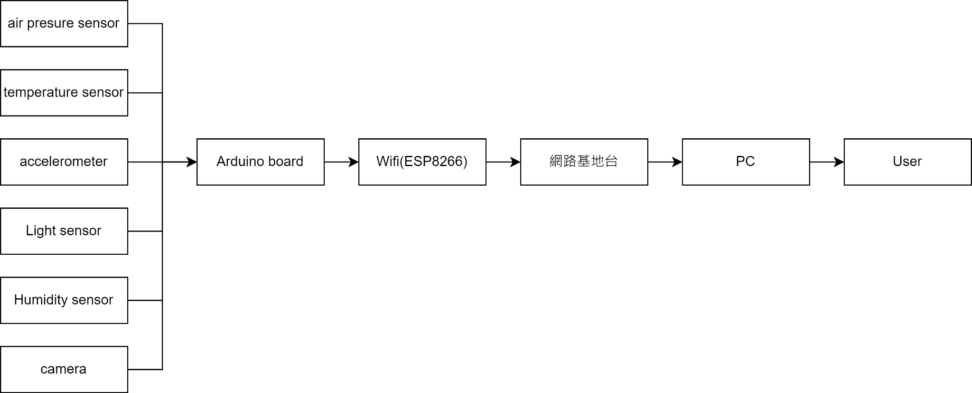
Sensing - Structure
資訊統合
資料傳輸
資料運算
結果呈現
資料由Arduino進行彙整，並透過Wifi傳輸，感測器量測值會輸入至MySql資料庫中，並透過網頁與APP進行呈現，並從中提取資料進行運算。

Slide 20
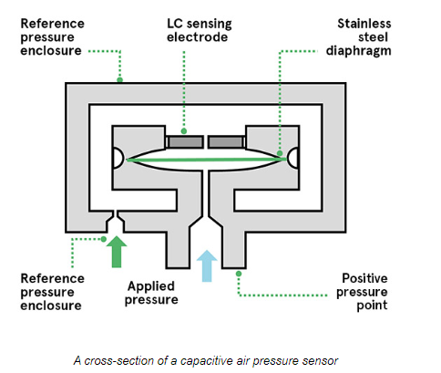
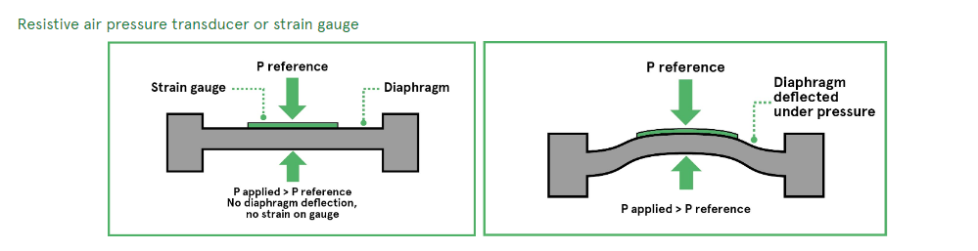
Sensing - air pressure sensor
For greater accuracy and control, air pressure sensors which convert pressure’s effect into a proportional electrical signal.
Transducer / Capacitive air pressure transducer.
use air pressure sensors to control air pressure for massaging muscles.
We use Capacitive air pressure transducer.
Notes:
Capacitive air pressure transducer
在這種方法中，兩個容量板通過很小的間隙彼此分離。一個是固定的，而另一個（與空氣接觸）充當彈性隔膜（請參閱右側的圖表）。增加空氣壓力使隔膜變形，縮小缺口并減小容量。容量的變化被轉換成電信號。
Inductive air pressure transducer
使用產生感應電流的原理，將隔膜的變形轉換成鐵磁核心的線性運動。核心的運動導致另一個輔助接頭繞組上由交流電源驅動的繞組產生的感應電流的變化。這種變化反過來又被轉換成電信號。
通常來說，按摩椅的氣壓感測器會使用電阻式氣壓感測器。這是因為電阻式氣壓感測器具有較低的成本、較簡單的結構、較低的敏感度、較低的精度和較低的溫度穩定性

Slide 21
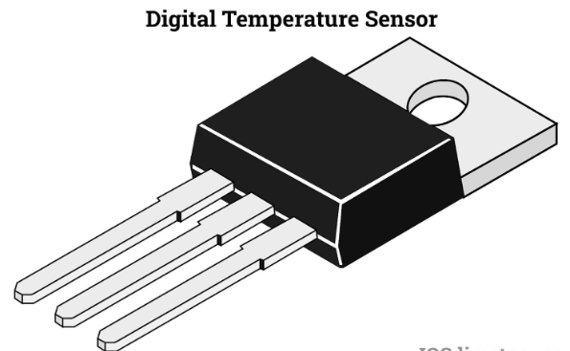
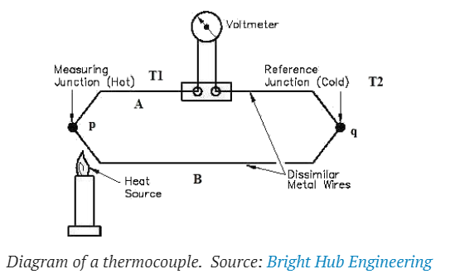
Sensing- temperature sensor
Contact-type temperature sensors and non-contact temperature sensors.
Use contact-type temperature sensors
simple structure, low cost, fast temperature detection speed, and high accuracy
suitable for measuring the surface temperature of the massage chair.
Use non-contact temperature sensors
infrared thermometers or thermal imagers
measure skin or vascular temperature of the human body.
Using an infrared thermometer to monitor the temperature of the air in our cockit.
Notes:
溫度感測器通常是通過測量溫度對某種物理量的影響來工作的。
溫度感測器可以分為兩大類：接觸式溫度感測器和非接觸式溫度感測器。接觸式溫度感測器必須直接接觸到待測物，並測量接觸點的溫度。常見的接觸式溫度感測器有溫度計、溫濕度計和熱電偶。
非接觸式溫度感測器不需要直接接觸到待測物，而是測量待測物的溫度和熱輻射。常見的非接觸式溫度感測器有紅外溫度計、熱成像儀和光學溫度計。
按摩椅通常會使用接觸式溫度感測器，如溫度計或熱電偶。這是因為接觸式溫度感測器具有較簡單的結構、較低的成本、較快的溫度偵測速度和較高的精度，適合用於測量按摩椅的表面溫度。
另外，按摩椅也可能會使用非接觸式溫度感測器，如紅外溫度計或熱成像儀，以測量人體的肌膚溫度或血管溫度。
在智慧居家中，使用非接觸式溫度感測器或接觸式溫度感測器都可以，具體選擇哪種感測器取決於您的居家系統的需求。
非接觸式溫度感測器具有較高的敏感度、較快的溫度偵測速度、較好的卫生性和較低的成本，適用於不需要精確控制溫度的場合。例如，您可以使用紅外溫度計來監控居家空氣的溫度。

Slide 22
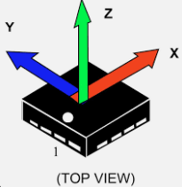
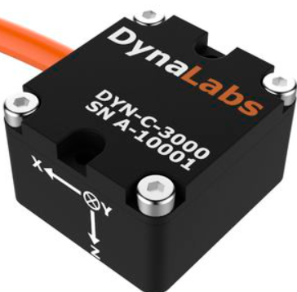
Sensing - accelerometer
measures the acceleration of an object.
It typically consists of a mass suspended on a support and a sensor
measures the displacement of the mass.
We use three-axis accelerometer.
three axes measure acceleration along each of these axes (X, Y, Z).
accurately detect the posture and movement of the human body
adjust the intensity and frequency of the massage based on the body's movement.
Notes:
加速度感測器（accelerometer）是一種能夠測量物體加速度的感測器。它通常由一個有質量的振子懸掛在一個支架上，並通過傳感器測量振子的位移。當振子受到外界加速度作用時，它會產生位移。傳感器可以測量這個位移，並將其轉換成電信號。通過對電信號的分析，可以推算出外界加速度的大小和方向。
按摩椅通常會使用三軸加速度感測器，也稱為三軸加速度計。這種感測器具有三個軸向，可以分別測量物體在三個軸向（X、Y、Z軸）上的加速度。通過三軸加速度感測器，按摩椅可以準確地感測到人體的姿勢和動作，並根據人體的動作來調節按摩的強度和頻率。

Slide 23
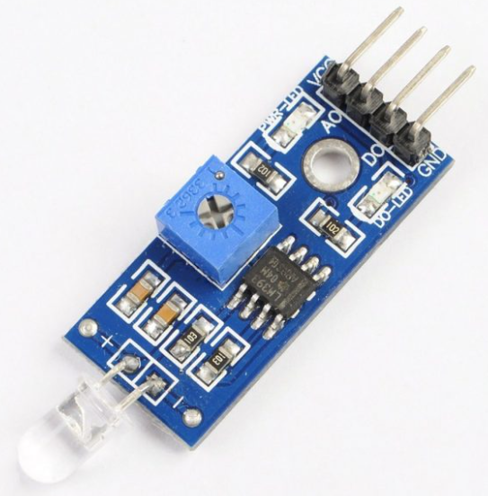
Sensing - Light sensor
photoresistor or photodiode
We use photodiode in dark mode
light intensity in a room is weak -> photodiode may result in decrease in the accuracy
photodiode -> Higher sensitivity and accurately measure weaker levels of illumination
We use photoresistor for light mode
higher sensitivity in strong levels of illumination and lower noise
allowing it to accurately measure strong levels of illumination.
In a room, the light is generally stronger, so using a photodiode can provide more accurate measurement results.
Notes:
智慧居家的光感應器通常會使用光敏電阻或光電二極體作為光感應器。
光敏電阻是一種導電性材料，在接受光照時，它的電阻值會改變。光感應器中使用光敏電阻時，會將光敏電阻與一個電阻或電容組成電路，根據電路的電阻或電容值的變化來測量光照強度。光敏電阻具有低成本、簡單的結構和較高的敏感度，適用於測量較弱的光照強度。
光電二極體是一種電子元件，在接受光照時，它會產生電流。光感應器中使用光電二極體時，會將光電二極體與一個電阻或電容組成電路，根據電路的電流或電壓值的變化來測量光照強度。光電二極體具有較高的敏感度和較低的噪音，適用於測量較強的光照強度。
在測量房間內光線是否充足的狀況時，使用光電二極體可能較為合適。
光電二極體具有較高的敏感度和較低的噪音，能夠準確地測量較強的光照強度。在房間內，光線一般都比較強，因此使用光電二極體可以獲得較精確的測量結果。
但是，如果房間內的光線強度很弱，使用光電二極體可能會導致測量的精度下降。在這種情況下，使用光敏電阻可能更合適，因為光敏電阻具有較高的敏感度，能夠準確地測量較弱的光照強度。

Slide 24
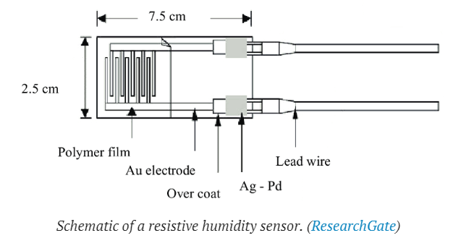
Sensing - Humidity sensor
capacitive / resistive humidity sensors.
We use resistive humidity sensor
the resistance value changes with changes in humidity.
low-priced
easy to use
fast response speed
often used in smart homes to monitor humidity.
Notes:
使用電容式溼度感測器（Capacitive sensors）可以監測一個薄金屬條放置在其中間的電容（即存儲電荷的能力）。隨著溼度感測器環境中的溼度變化，金屬的電容會以直接成比例的速率增加或減少。溼度增加產生的電荷差（電壓）被放大後傳送到嵌入式計算機進行處理。而電阻式溼度感測器（Resistive humidity sensors）則運作在不同的原理上。這些感測器使用一小條聚合物梳子，隨著溼度變化而增大或減小，這會直接影響系統存儲電荷的能力。

Slide 25
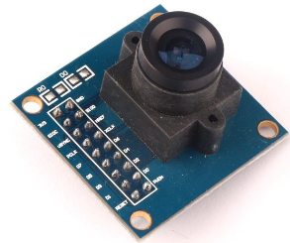
Sensing - Camera
OV7670 Colour Camera
low-cost image sensor
Low power consumption
High-quality image
On-chip image processing : built-in image processing features
ex: white balance, color correction, and gamma correction , improve the quality of the captured images
Versatility : parallel, serial, and USB.
30 fps in VGA
Gesture recognition, posture recognition, and environmental object recognition.
Notes:
OV7670是一款彩色攝像晶片，常用於構建相機模塊。它具有低功耗、小尺寸、高解析度和低成本等特點，適用於各種應用，如手機、平板電腦、汽車駕駛輔助系統、工業監控等。OV7670採用CMOS技術，能夠提供高質量的彩色圖像，並具有自動曝光、自動白平衡、類比數字轉換和數字信號處理等功能。

Slide 26
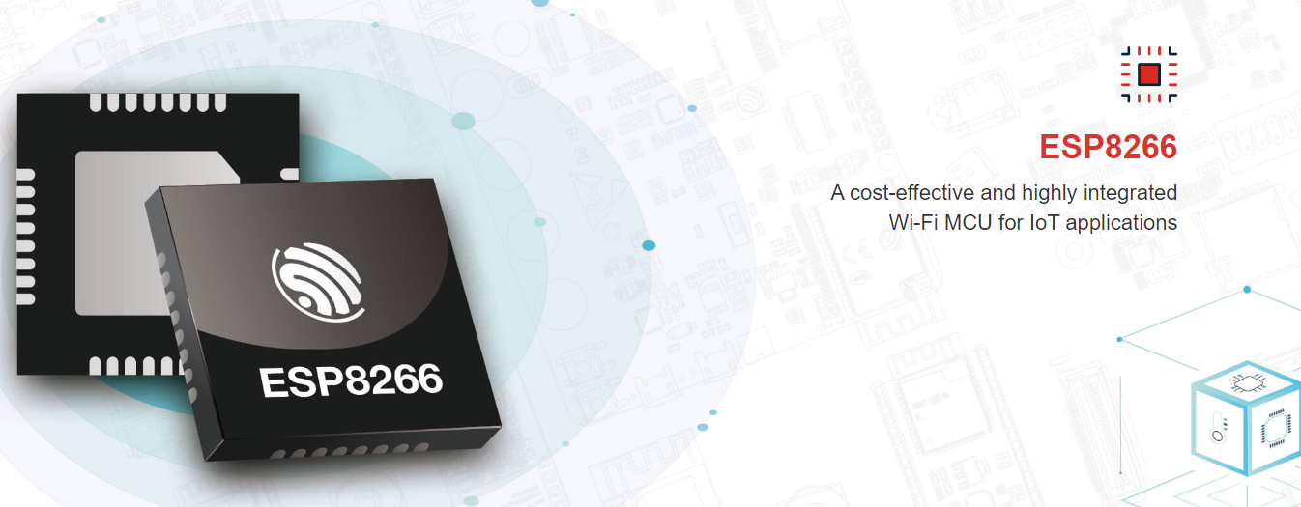
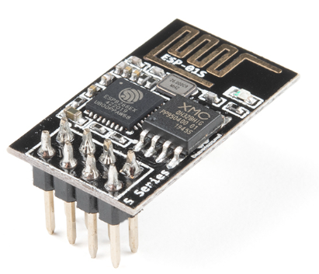
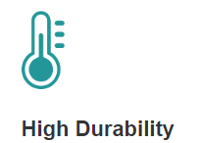
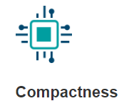
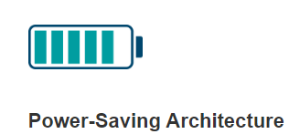
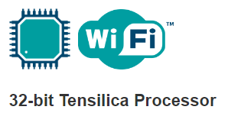
Sensing - Wifi
ESP8266 Wifi MCU
ESP8266 is a low-cost Wi-Fi microchip with full TCP/IP stack and microcontroller capability produced by Espressif Systems
capable of functioning consistently in industrial environments
integrated with a 32-bit Tensilica® processor
low power consumption
Tensilica L106 32-bit RISC processor
extra-low power consumption
reaches a maximum clock speed of 160 MHz
The Real-Time Operating System (RTOS) and Wi-Fi stack allow about 80% of the processing power to be available for user application programming and development.
Notes:
ESP8266EX 的工作温度范围大，且能够保持稳定的性能，能适应各种操作环境 ESP8266EX 集成了 32 位 Tensilica 处理器、标准数字外设接口、天线开关、射频 balun、功率放大器、低噪放大器、过滤器和电源管理模块等，仅需很少的外围电路，可将所占 PCB 空间降低。ESP8266EX 专为移动设备、可穿戴电子产品和物联网应用而设计，通过多项专有技术实现了超低功耗。ESP8266EX 具有的省电模式适用于各种低功耗应用场景。ESP8266EX 内置超低功耗 Tensilica L106 32 位 RISC 处理器，CPU 时钟速度最高可达 160 MHz，支持实时操作系统 (RTOS) 和 Wi-Fi 协议栈，可将高达 80% 的处理能力留给应用编程和开发。
https://www.espressif.com/zh-hans/products/socs/esp8266

Slide 27
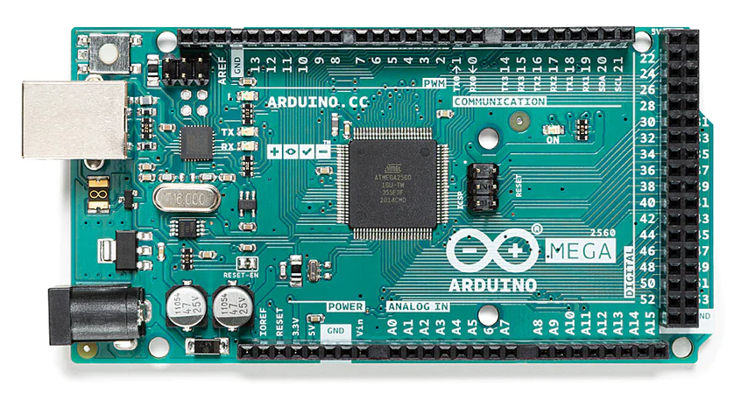
Sensing - Board
Arduino Mega 2560 Rev3
microcontroller board based on the ATmega2560 microprocessor.
54 digital input/output pins
16 analog inputs
4 UARTs (hardware serial ports)
a 16 MHz crystal oscillator
a USB connection
popular choice for projects that require more I/O lines, more memory, and higher processing power than the Arduino Uno can provide.
Notes:
Arduino Mega 2560 Rev3 是一種基於 Atmel AVR 微控制器的開發板。它具有 54 個數位輸入/輸出 (I/O) 腳位、16 個類比輸入腳位、4 個 UART 腳位（串列傳輸介面）、一個 16 MHz 的晶振、一個 USB 轉接器、一個保險模塊以及一個 DC 轉換器。
Arduino Mega 2560 Rev3 的主要特點包括：
大量的 I/O 腳位：可以連接各種感測器和輸出裝置
可程式的類比輸入腳位：可以接收類比信號，如音頻信號
支援多種通訊協定：可以連接各種裝置，如網絡、藍牙、Zigbee 等
支援多種燒錄器：可以使用不同的工具來燒錄程式

Slide 28

Technology
Storage Device : QLED Curved Monitors
Display : 8 TB V NAND SSD
QLED Curved Monitors
8 TB V NAND SSD

Slide 29
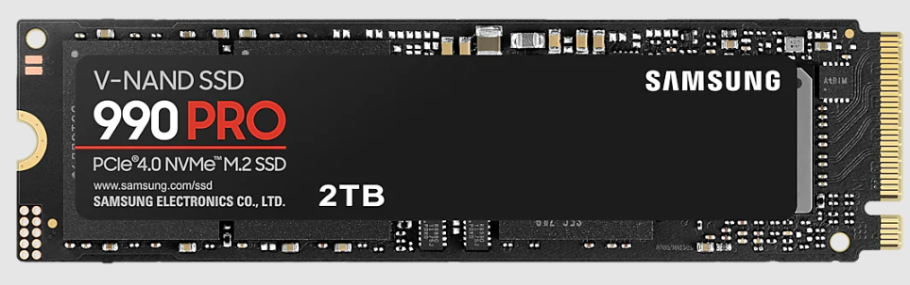
Technology - Storage Device
We use Samsung 990 PRO PCIe 4.0 NVMe M.2 SSD 2TB *4
Interface : PCIe Gen 4.0 x4, NVMe 2.0
Storage Memory : Samsung V-NAND 3-bit MLC
Speed : 40% and 55% faster random read/write speeds than 980 PRO - up to 1400K/1550K IOPS,while sequential read/write speeds up to 7450/6900 MB/s reach near the max performance of PCIe® 4.0
Smart thermal solution : Speed beyond the heat.The heat spreader label controls NAND chip heat, while Dynamic Thermal Guard keepstemperatures optimal.

Slide 30
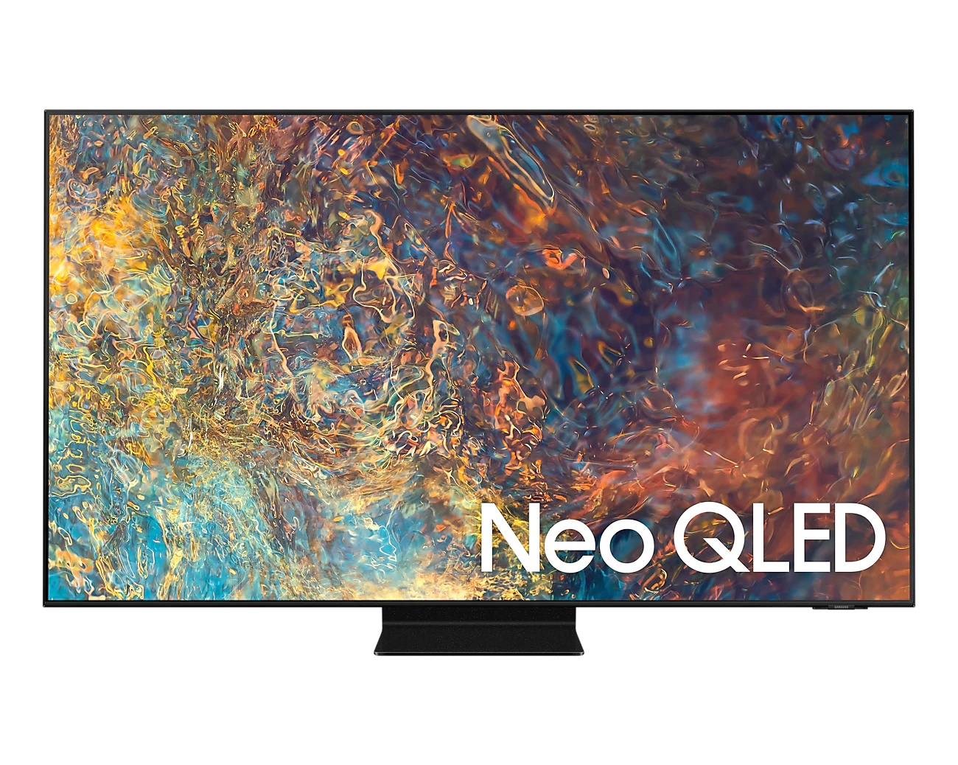
Technology - Display
We use 98" Class QN90A Samsung Neo QLED 4K Smart TV to display.
It has 4K@120fps, Dolby Digital Plus, Active Voice Amplifier
Neo Quantum Processor 4K : The Neo Quantum Processor 4K utilizes advanced AI based deep-learning analysis to analyze the signal, source, and scene-by-scene content to deliver best 4K optimized experiences.
Quantum HDR 32x : Can helps reveal what you might have missed in particularly dark or light scenes, making them pop with vivid, breathtaking colour.
Quantum Matrix Technology : By developing proprietary Mini LEDs shrunk to 1/40th the size of other backlights, and introducing a micro layer for precise light control. Has deeper blacks and brilliant brightness and contrast.

Slide 31
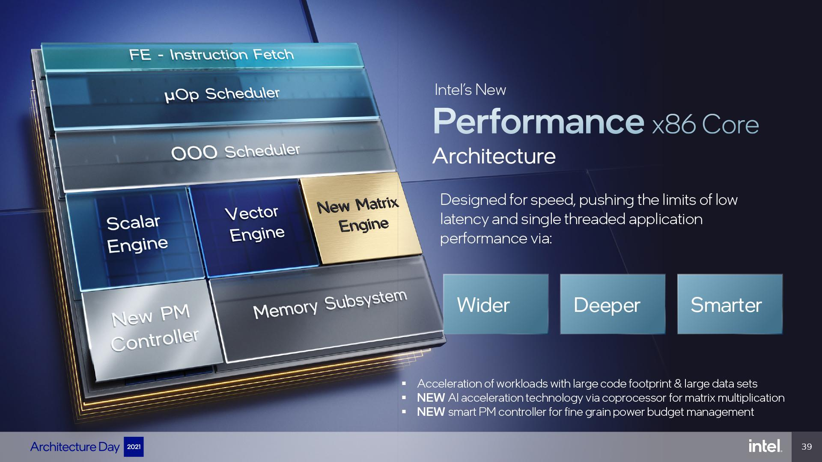
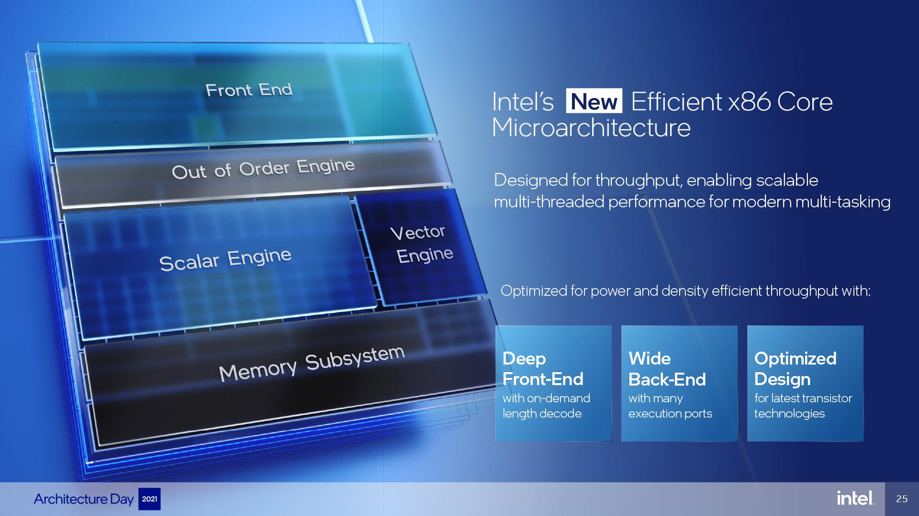
Technology - IOT Control system + Entertainment devices
Intel 13rd core
8 Performance-core
16 Efficient-core
16 PCIe 5.0
DDR5 & DDR4
NVIDIA GeForce RTX 4090
Boost Clock 2.52GHz
Memory size 24GB
Max Display Resolution 4K at 240Hz or 8K at 60Hz

Slide 32
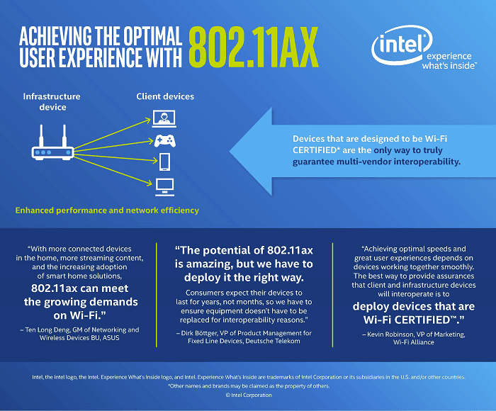
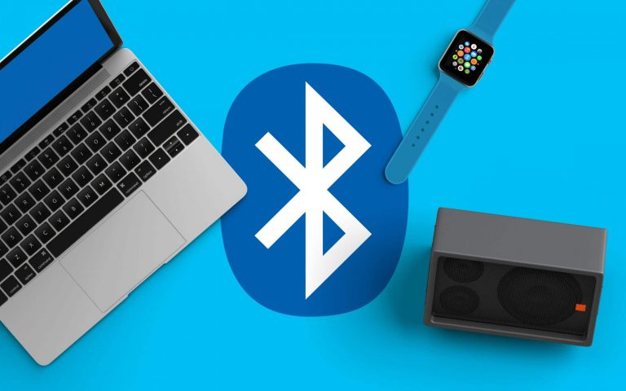
Technology -WIFI6 AND Bluetooth 5.3
WIFI 6 : IEEE 802.11ax
Speeds can be faster when compared to Wi-Fi 5.
Wi-Fi 6 can result in up to 75% less latency
Wi-Fi 6 brings wired and wireless signals closer to parity.
Bluetooth 5.3
Periodic Advertising Enhancement
Encryption Key Size Control Enhancements
Channel Classification Enhancement.
Notes:
What Is Wi-Fi 6? - Intel
Wh
at's New With Bluetooth 5.3 - Dignited

Slide 33
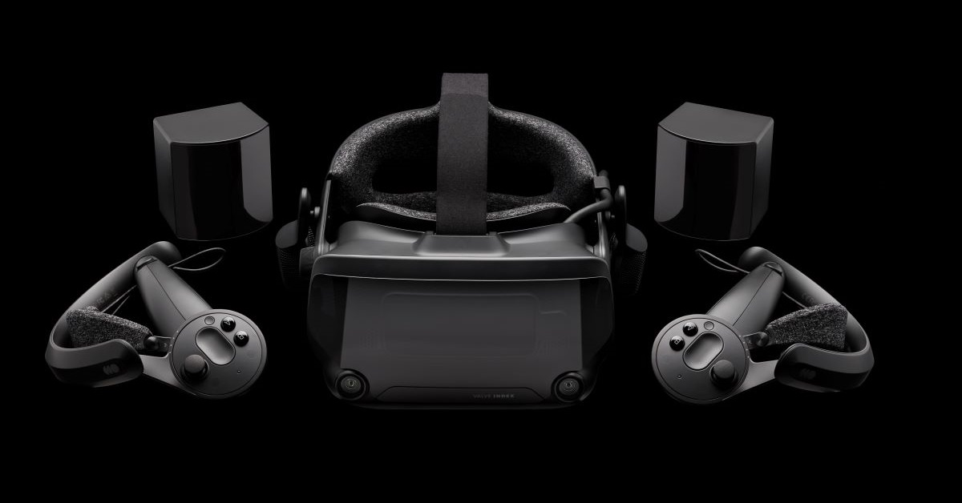
Technology - Valve Index
Headset
Controllers
Base Station

Slide 34
Technology - Valve Index
Excellent screen and field of view:
Display: Two 1440×1600 LCD IPS Fast Switching Type Displays @ 80 Hz, 90 Hz, 120 Hz, or 144 Hz
Camera: Stereo 960 x 960 pixel, global shutter, RGB (Bayer)
Field of View (FOV): Optimized eye relief adjustment allows a typical user experience 20º more than the HTC Vive
Superb audio:
Sound: Integrated headphones, 3.5mm audio jack, built-in dual microphone array
Immersive, finger-tracking controllers:
Each controller uses 87 sensors to track hand position, finger position, motion, and pressure to determine user intent. All of these signals, combined with fine-tuned software and algorithms, give us a better understanding of how a player is holding and using the controllers.
Notes:
每隻控制器皆配有 87 個感應器，用來追蹤手部位置、手指位置、動作與壓力，藉以判斷使用者的意圖。將所有訊號與精準調整的軟體和演算法結合在一起，我們便能進一步了解玩家手持和使用控制器的方式。

Slide 35
Part 5
Market Analysis

Slide 36
SWOT
Strengths:
Convertible environment
Multifunction
Safe for user
Weaknesses:
Cost is expensive
Waste too much time on games
Opportunities:
Reduce cost
Forced end mechanism
Threats:
User range is too small
VR/AR

Slide 37
Part 6
Task Partition

Slide 38
Task Partition
Technology analysis
Smart cockpit : 許鏡瑋，黃柏凱
Entertainment devices : 陳峒羽，郭孟軒
Smart home Control system :許祐杰，許鏡瑋，黃柏凱，陳峒羽，郭孟軒
Report
許鏡瑋，郭孟軒，黃柏凱，陳峒羽，許祐杰
Notes:
introduction: Ching Wei
architecture: Martin,凱凱
swot: 陳峒羽

Slide 39
Part 7
Reference

Slide 40
Reference
[1]https://www.avnet.com/wps/portal/abacus/solutions/technologies/sensors/pressure-sensors/media-types/air
[2]https://www.fierceelectronics.com/sensors/what-a-temperature-sensor
[3]https://www.omega.com/en-us/resources/accelerometers
[4]https://www.brickcom.com.tw/news/press-release_detailview.php?id=283
[5]https://www.fierceelectronics.com/sensors/what-a-humidity-sensor
[6]https://www.taiwaniot.com.tw/product/ov7670-colour-camera-%E6%94%9D%E5%83%8F%E6%94%9D%E5%BD%B1%E6%A8%A1%E7%B5%84/
[7]https://www.espressif.com/zh-hans/products/socs/esp8266
[8]https://store.arduino.cc/products/arduino-mega-2560-rev3

Slide 41
Reference
[9]https://www.samsung.com/tw/memory-storage/nvme-ssd/990-pro-2tb-nvme-pcie-gen-4-mz-v9p2t0bw/
[10]https://semiconductor.samsung.com/consumer-storage/internal-ssd/990-pro/
[11]https://www.samsung.com/tw/tvs/qled-tv/qn90a-98-inch-neo-qled-4k-smart-tv-qa98qn90aawxzw/
[12]https://www.samsung.com/us/televisions-home-theater/tvs/samsung-neo-qled-4k/98-class-qn90a-samsung-neo-qled-4k-smart-tv-2021-qn98qn90aafxza/
[13]https://www.samsung.com/au/tvs/qled-tv/qn90a-98-inch-neo-qled-4k-smart-tv-qa98qn90aawxxy/
[14]https://www.intel.com.tw/content/www/tw/zh/gaming/resources/wifi-6.html
[15]https://www.dignited.com/99428/bluetooth-5-3/
[16]https://www.valvesoftware.com/zh-tw/index

Slide 42
Thank you

